Slide 1








Robotics Lab 1
Python Programming in
Linux Ubuntu
MUNADI SIAL
School of electrical engineering and computer science
National University of Sciences and Technology

Slide 2
Code of Ethics
All students must come to the lab on time
Respect faculty and peers through speech and actions
Students must remain attentive and should not be sleeping during the lab
Students must be physically and mentally present in the lab in order to be marked for attendance
Discussion unrelated to lab is NOT allowed
Eating and Drinking are strictly prohibited in the lab
Mobile phone use is NOT allowed. Students found to be using mobile phone in the lab will not be marked as present
Do NOT tamper with the layout of the lab reports or change the front page of the lab report. Failing to do so will render the report invalid for checking
Despite the group submission of reports, students must work individually during the lab hours

Slide 3
Code of Ethics
Late submission of lab reports are not guaranteed to be checked
If a late submitted report is checked, it will be subjected to severe penalty so that for every 3 days late, 1 mark will be deducted. Thus, there is no point in submitting lab reports after 30 days
Sharing of code is NOT permitted
After completing the lab, ensure that you have deleted the lab files from the lab computer. It is the student's responsibility to ensure that none of the files are copied by other students
Copying of lab reports will get zero tolerance. Even if one instance, task, screenshot or piece of code is found to be copied then both the copying and the copied report will get zero marks
Before leaving the lab at the end, shut down the lab computer and place the seats back in their original position

Slide 4
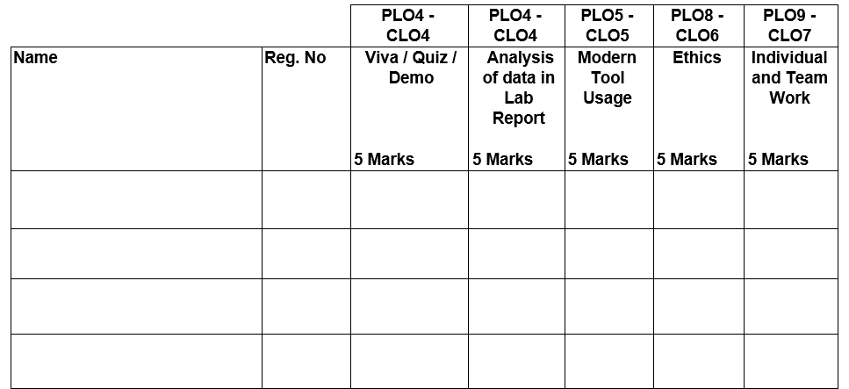
Lab Marking

Slide 5
Lab Overview
In this Lab, you will learn the following:
Ubuntu: A popular Linux-based operating system
Python: Programming language used widely in robotics
Robot Operating System (ROS): A middleware for programming robots in a simulation environment
Gazebo: Physics simulator
OpenCV: Library for image processing and computer vision

Slide 6
What is a Robot?

Slide 7
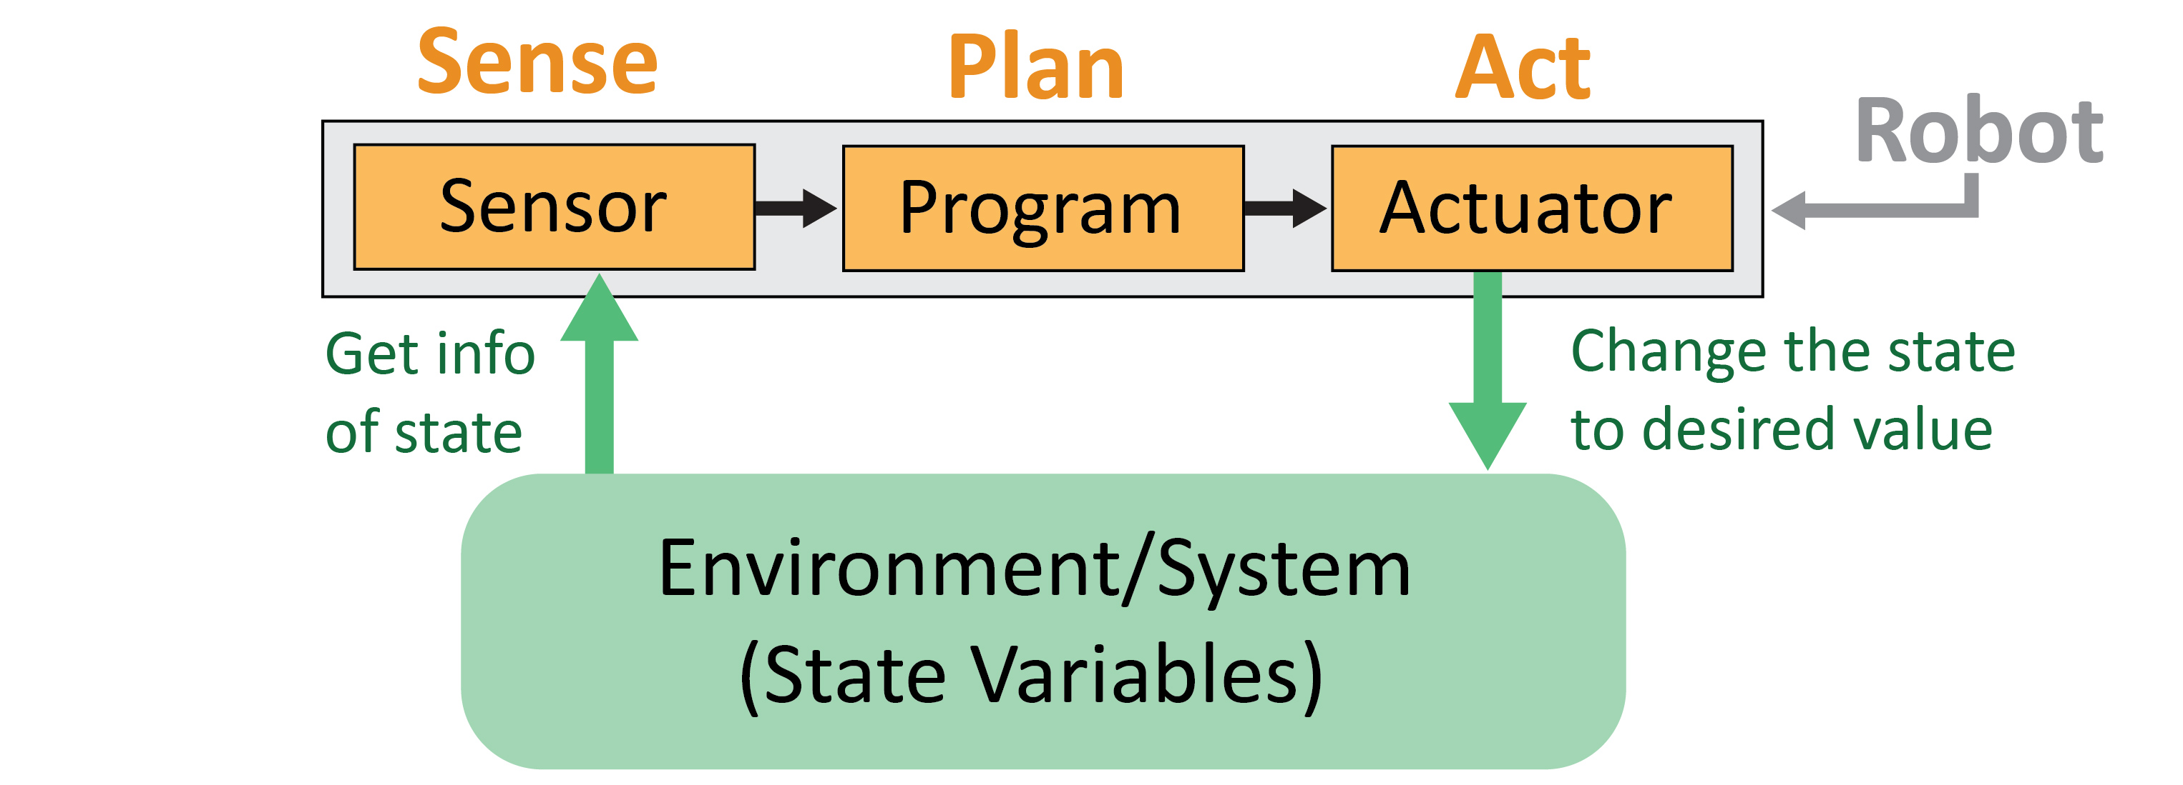
What is a Robot?
“A Robot is a programmable, goal-oriented machine that can sense, plan and act to carry out a complex series of activities”
The environment contains the state variables of interest which depend on the application. For example, consider a robot that wants to move from start to end position. Here, the state variable is the robot’s own position, i.e. the x and y coordinates of the robot’s center point in the map.

Slide 8
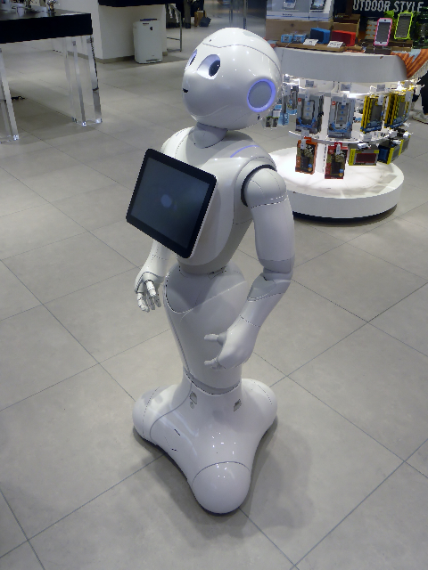
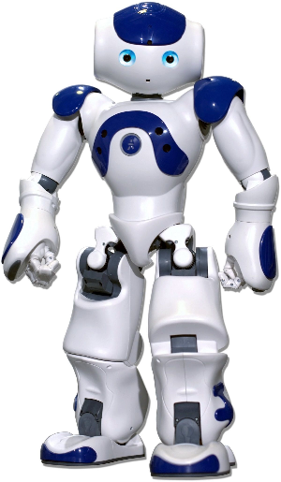
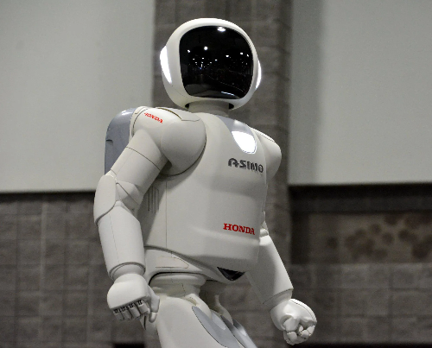
Robot Examples - Humanoids
Nao
A popular humanoid robot used widely for research and educational purposes
ASIMO
ASIMO can interact with humans by recognizing human gestures and voice commands.
Pepper
A service robot that can recognize emotions through facial expressions and is used for assisting people

Slide 9
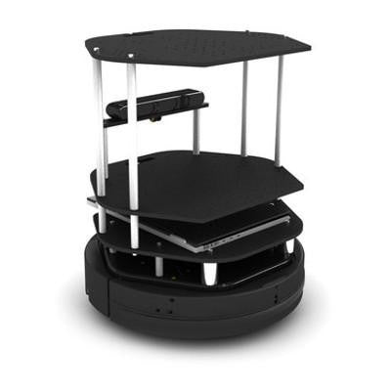
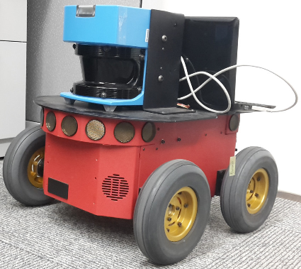
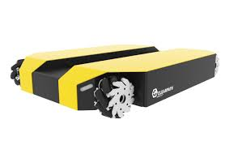
Robot Examples - Wheeled
TurtleBot 2
A mobile robot platform which is used primarily for educational purposes
Pioneer 3-AT
An all-purpose outdoor robot with support for 16 SONARs and a LASER scanner
Dingo
A compact, light-weight, mobile robot for indoor use

Slide 10
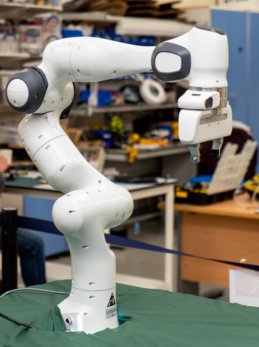
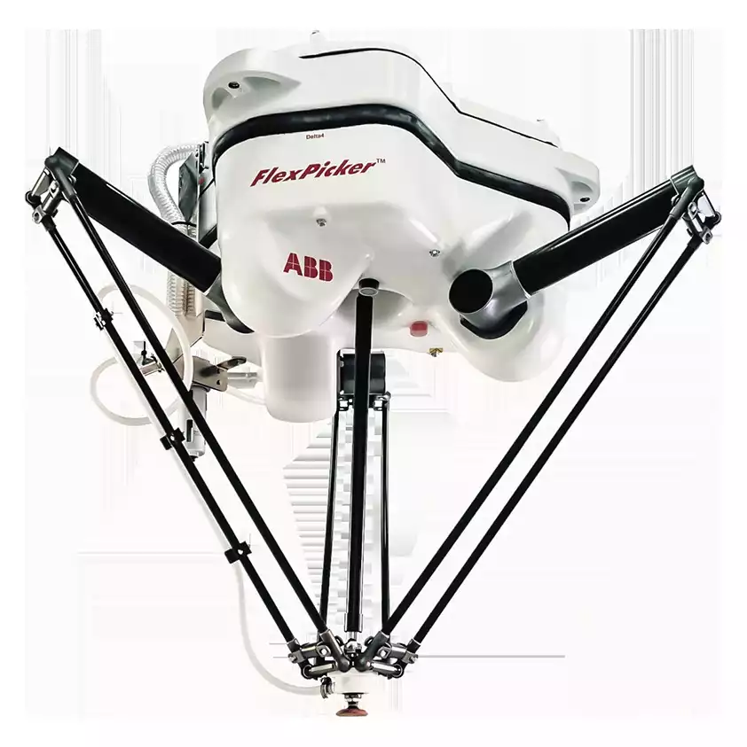
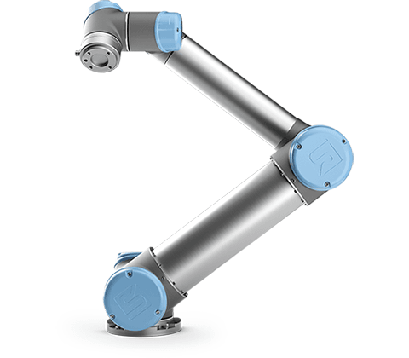
Robot Examples - Manipulators
UR5 Robot Arm
An industrial arm used to automate tasks in the manufacturing sector
ABB IRB 340
A parallel-arm robot. Parallel arms mostly of research interest.
Franka Emika
A manipulator with seven degrees of freedom

Slide 11
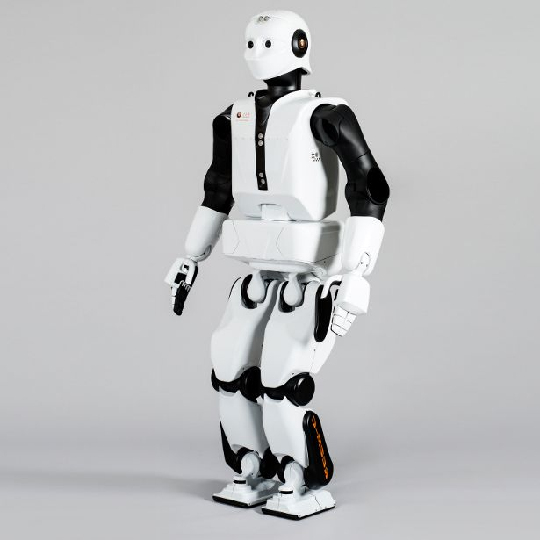
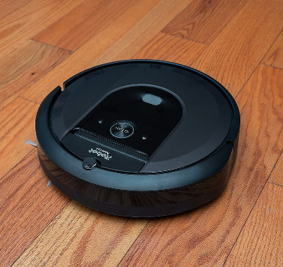
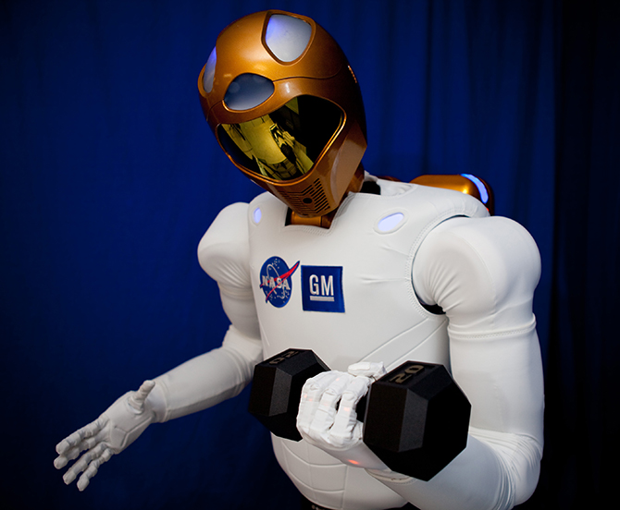
Robot Examples
Roomba
A home robot used for autonomous vacuum cleaning
RoboNaut 2:
A NASA robot used for various tasks in the International Space Station
REEM-C:
A humanoid robot with walking capability used for research purposes

Slide 12
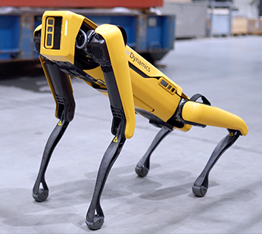
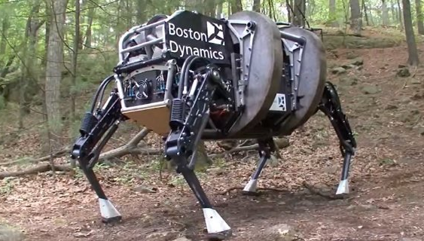
Robot Examples - Legged
Spot
A canine-inspired quadruped (4-legged) robot
BigDog
A quadruped created for military applications by Boston Dynamics. It was engine-driven and could stand, sit, walk and run in a stable manner. It was discontinued due to the engine’s high noise

Slide 13
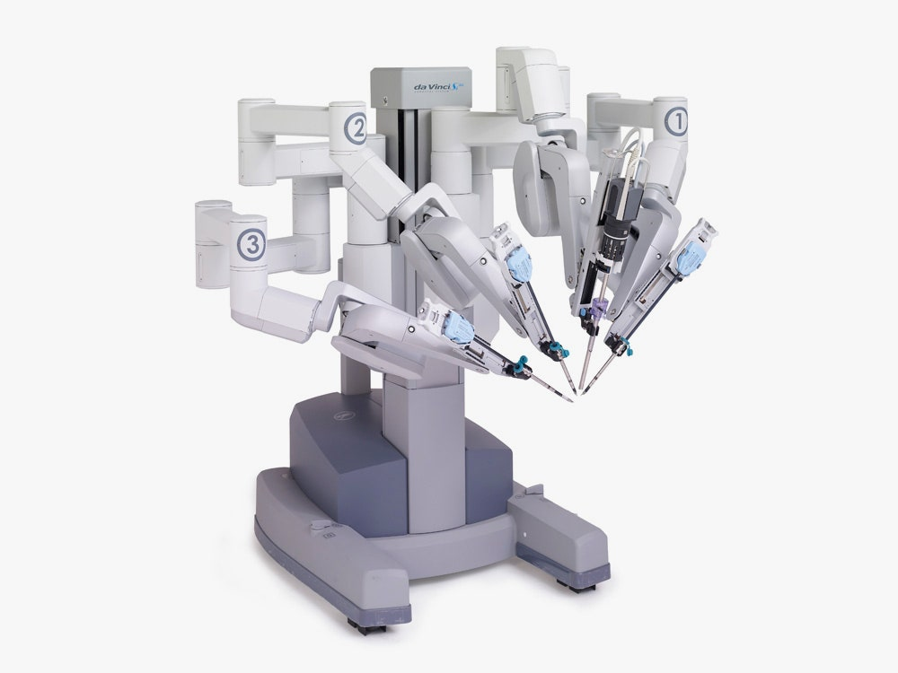
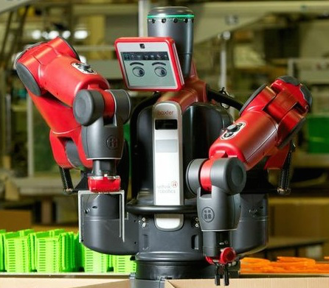
Robot Examples
Baxter
A “human-safe” robot that operates at low speed
Da Vinci Surgical System
A multi-arm robotic system that can hold scissors, scalpels, graspers, cameras etc. for surgical purposes. A human surgeon controls the robot via a console to perform surgery with great precision

Slide 14
Robotics Field
Robotics is a relatively young field with highly ambitious objectives. The ultimate goal of robotics is the creation of machines that can act, behave and think like humans.
Robotics is a field that integrates concepts from various disciplines:
Mechanical Engineering:
Position, velocity, acceleration
Gear drives, lead screws
Forward and Inverse kinematics
Manipulator dynamics
Structural stresses
Electrical Engineering:
Electronic circuits
Electric motors
Batteries
Sensors
Computer Engineering:
Programming
CPU, GPU
Computer vision
Control Theory:
Linear control
Nonlinear control
Mathematics:
Linear algebra
Probability
Numerical methods

Slide 15
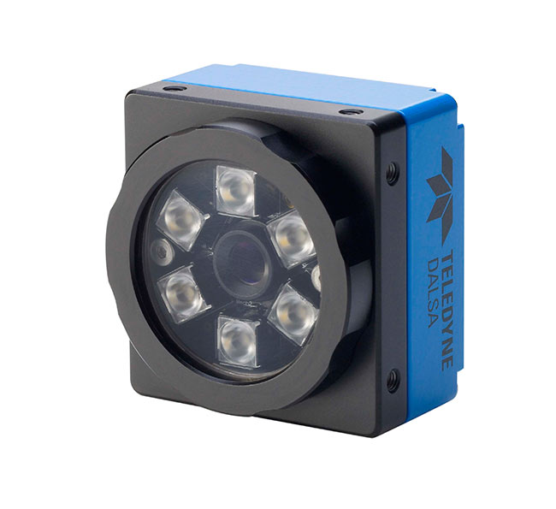
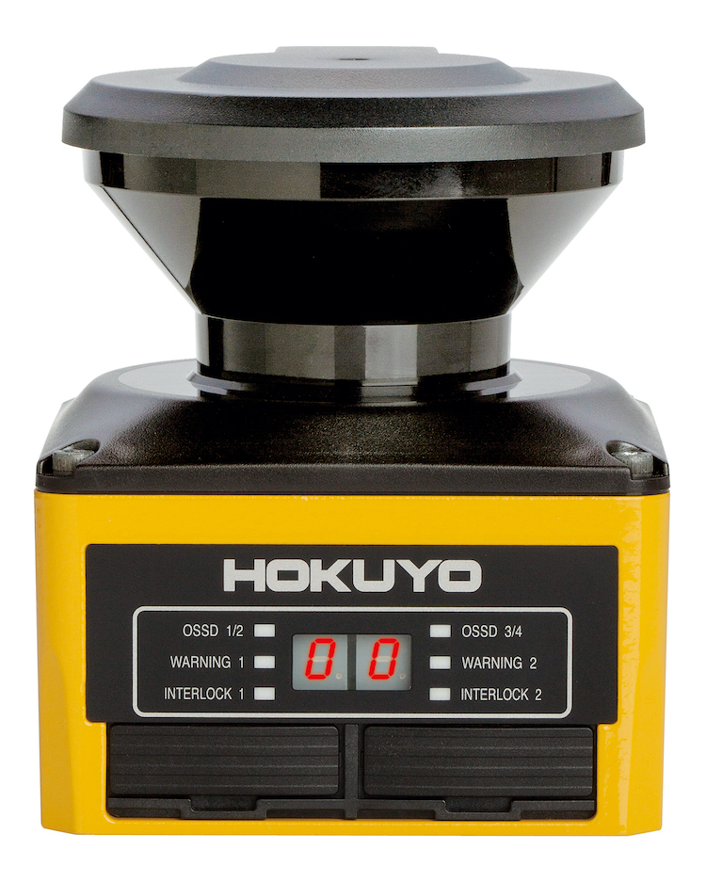
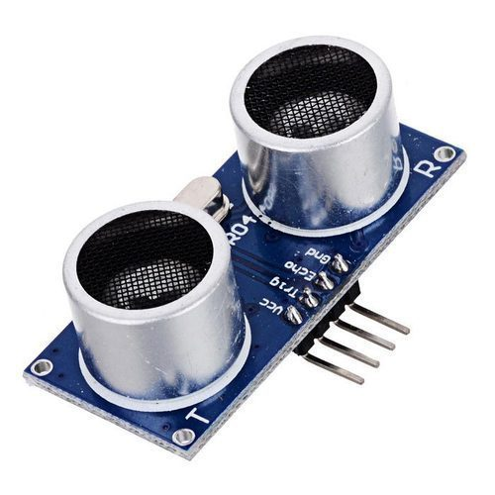
Sensors
Sensors are devices used to get useful information from the environment
Vision Sensor
CCD/CMOS camera
LASER Scanner
Measures distance from obstacle
SONAR
Measures distance from obstacle

Slide 16
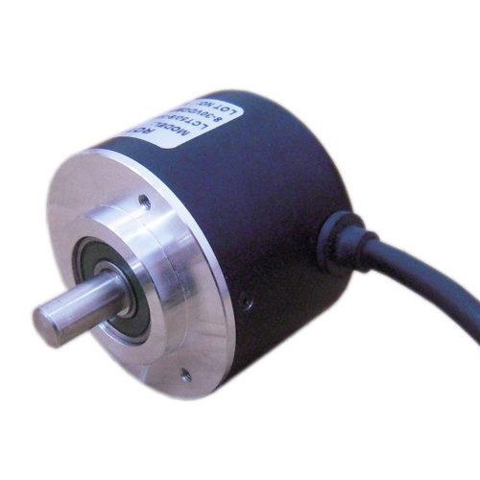
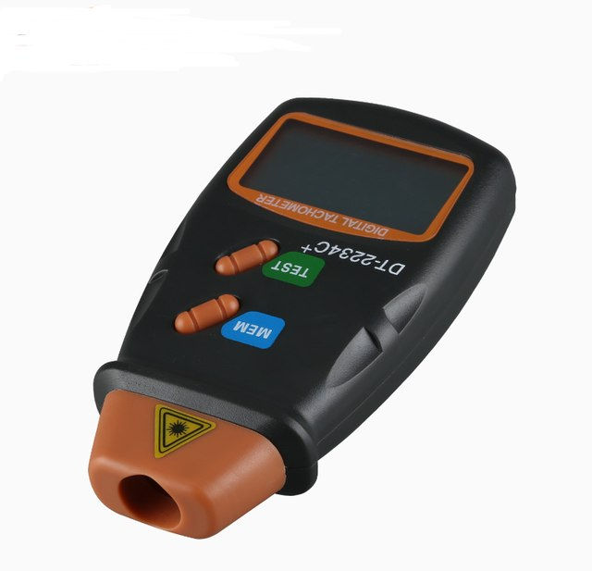
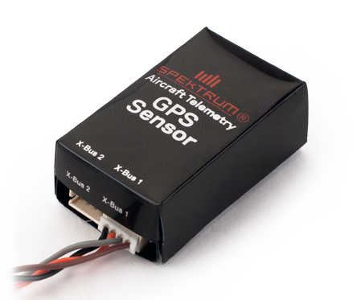
Sensors
Sensors are devices used to get useful information from the environment
Encoder
Measures angular position
Tachometer
Measures angular velocity
GPS
Measures location in outdoor environments

Slide 17
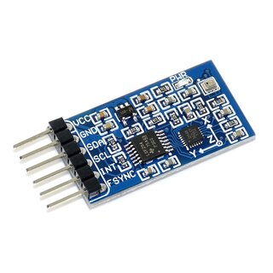
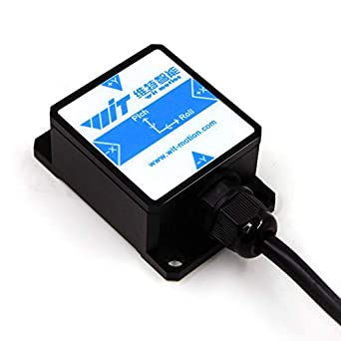
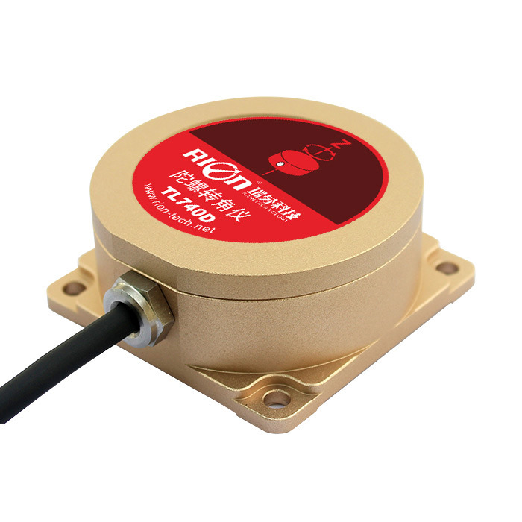
Sensors
Sensors are devices used to get useful information from the environment
IMU
Accelerometer and gyroscope combined (compass is also included sometimes)
Accelerometer
Measures linear acceleration
Rate Gyroscope
Measures angular velocity of the body to which it is attached

Slide 18
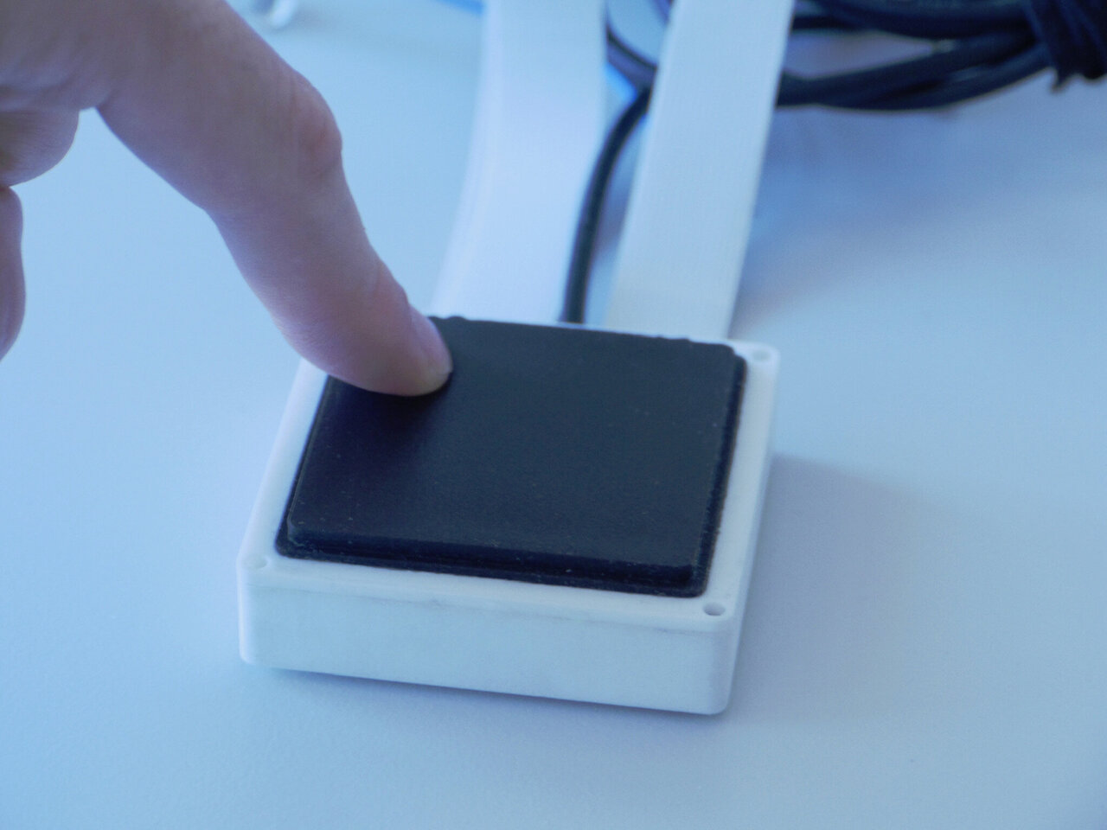
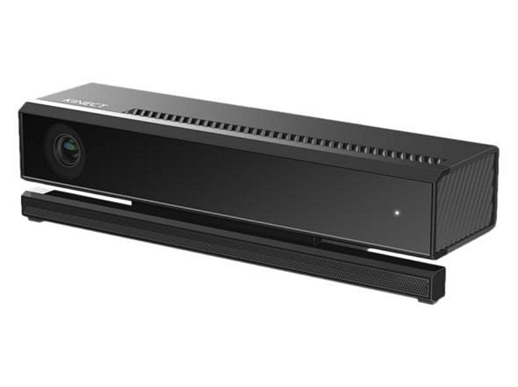
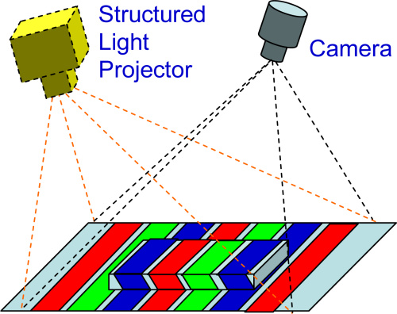
Sensors
Sensors are devices used to get useful information from the environment
Tactile Sensor
Used to sense touch by detecting bumps
Kinect Sensor
Projects “structured light” on the scene and the change in pattern is used to obtain information of the scene geometry

Slide 19
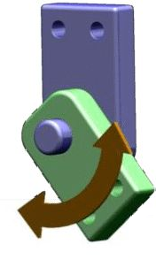
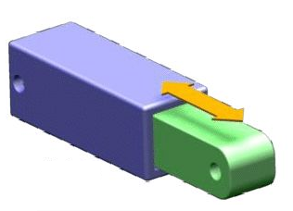
Actuators
Actuators are devices that change the variables of the system
In robotics, electric motors are the dominant actuators which are used in the wheels and in the joints of arms and legs
Pneumatic and hydraulic actuators are less common
The most common joint types in robots are:
Revolute joints
Prismatic joints
Revolute Joint
Prismatic Joint

Slide 20
Advantages & Disadvantages of Robots
Advantages of Robots:
Robots can perform tasks with great precision and accuracy
Robots can work in hazardous environments (heat, radiation etc)
Robots can work consistently without fatigue
Robots can process multiple tasks simultaneously
Robots have repeatable precision at all times
Robots can increase productivity and quality of products
Disadvantages of Robots:
Robots are expensive
Robots replace human work which can lead to economic issues
Robots lack capability to respond in emergencies

Slide 21
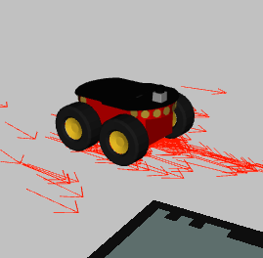
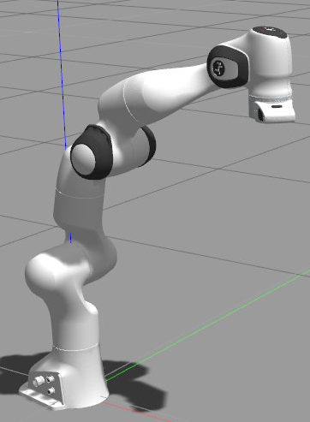
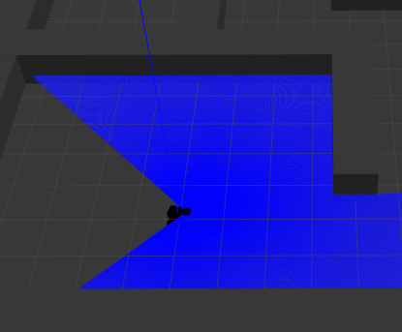
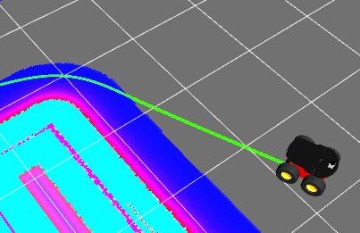
Robot Operating System (ROS)
ROS is a middleware that is used to facilitate for the complications which are due to integrating complex, multiple processes, multiple sensors and multiple actuators

Slide 22
Introduction to Robot Programming
Robotics programming is mostly done in C++ and Python
Robot Operating System or ROS has strong support for both C++ and Python
Python has a more simpler syntax which makes it easier to code
Python is ideal for developing prototypes quickly
In contrast, C++ has more complicated syntax but is more efficient in terms of computation
C++ is ideal for making finalized, industry-standard programs where performance is important
Basically, the choice of the language is a trade-off between performance and development time
When learning ROS, it is advisable to code in Python because it is easier that way

Slide 23


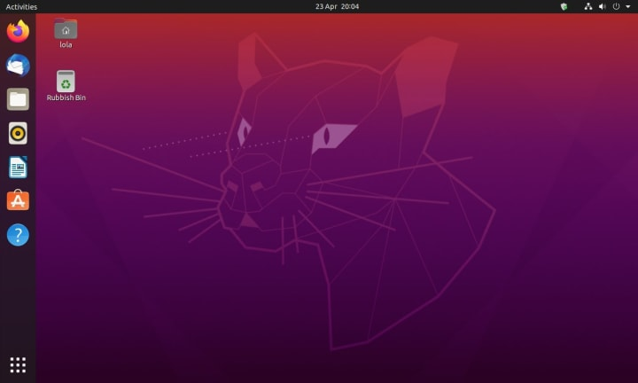
Linux Ubuntu
Ubuntu is a popular operating system based on the Linux distribution
Ubuntu is open-source and has LTS (Long-term Support)
Ubuntu has an easy-to-use installer that allows computers to dual-boot with another operating system (Windows or MacOS)
We will use Ubuntu because it has the most support with ROS
To use Ubuntu effectively, we need to learn the Terminal

Slide 24
The Linux Terminal
The Terminal is the command-line of Linux Ubuntu that gives precise control to the user and is extensively for efficient programming even among professionals
To learn ROS, familiarizing with the terminal is very important
In this lab, we will execute python scripts (.py) with the terminal
Let’s understand a few basic commands on the terminal:
pwd
ls
cd <directory>
cd ..

Slide 25
Python Language
Python is an interpreted, open-source language with an emphasis on code readability and has a very large community support
Consider the following comparison between C++ and Python codes:
Python C++
a = 10
b = “M”
c = 7.6
print(a,b,c)
int a = 10;
char b = “M”;
float c = 7.6;
cout << a << “ “ << b << “ “ << c << endl;
The output of both programs is the same:
>> 10 M 7.6
No semicolons are needed to end each line in Python
It is not necessary to declare the data type of variable in Python
The print() statement creates spaces and new line automatically

Slide 26
Python Scripts
Python scripts are files that end in .py format and contain the code
To write a script, we will use a text editor like SublimeText which allows syntax highlighting for python
Let’s write a simple python script and execute it via the terminal:
a = 10
b = “M”
c = 7.6
print(a,b,c)
Once you have typed the above code, save the script as test.py
Now open the terminal, go the directory (with cd) where you saved the script and execute it with the following command:
python test.py

Slide 27
Variables in Python
To add a comment in code, use # in Python
The data type of a variable can change in Python:
a = 10 # this will work
a = 5.5 # this will work
a = “house” # this will work
The equivalent code in C++ will give an error:
int a = 10; // this will work
a = 5.5; // error
a = “house”; // error

Slide 28
Data Types in Python
Python contains several data types, some of which are given below:
x_string = "Hello World"
x_integer = 25
x_float = 25.1
x_boolean = True
x_complex = 2j
x_list = [1, 2, 3, 4, 5]
x_tuple = (1, 2, 3, 4, 5)
x_set = {1, 2, 3, 4, 5}
x_dictionary = {"name":"Ali", "age":31}

Slide 29
Arithmetic Operators
The following code shows the arithmetic operators in Python:
a = 10
b = 3
add = a + b
sub = a - b
mul = a*b
div = a/b
quotient = a//b
remainder = a%b
power = a**b
print(add, sub, mul, div, quotient, remainder, power)
>> 13 7 30 3.3333333333333335 3 1 1000

Slide 30
Logical Operators
The following code shows the logical operators in Python:
a = True
b = False
print(a and b)
>> False
print(a or b)
>> True
print(not a)
>> False
print(not(a and b))
>> True
print(not(a or b))
>> False
print(not b)
>> True

Slide 31
Strings
Python supports the string data type which is an array of characters
h = “Manipulator”
print(h)
Output:
Manipulator
You can get individual characters with square brackets
print(h[0])
print(h[1])
print(h[8])
Output:
M
a
p
You can get the number of characters with the len() function
g = len(h)
print(g)
Output:
11

Slide 32
Strings
You can concatenate strings easily in python
c = “Computer”
d = “Vision”
e = c + d
print(e)
Output:
ComputerVision
f = c + “ “ + d
print(f)
Output:
Computer Vision
You can check if a character is present in the string with the “in” keyword
True
False
print(“t” in c)
print(“s” in c)
Output:

Slide 33
User Input
To get input from user, we use the input() function
v1 = input(“Enter the first number: ”)
print(v1)
v2 = input(“Enter the second number: ”)
print(v2)
Output:
Enter the first number: 200
200
Enter the second number: 100
100

Slide 34
User Input
The input() function returns a string data which is stored in the variable
If we add the previous two numbers, they will concatenate because they are strings, not numbers
print(v1 + v2)
Output:
200100
To compute the numeric sum, we need to convert the string data type to an int or float data type
v1 = int(v1)
v2 = int(v2)
print(v1 + v2)
Output:
300

Slide 35
If…Else
Python supports the IF…ELSE conditional statements which choose to execute statements depending if a condition is true or false
The syntax for a IF statement is given as:
if <condition>:
<statement_1>
<statement_2>
An example is given below:
a = 4
b = 3
if a > b:
print(“a is greater than b”)
The <condition> can be any of the following:
a==b a!=b a < b a > b a <= b a >= b

Slide 36
If…Else
The else keyword contains statements that execute when the condition is not met
a = 4
b = 3
if a > b:
print(“a is greater than b”)
else:
print(“b is greater than a”)
Note that the colon symbol is part of the syntax
To contain statements, they are indented with spaces
The indents are mandatory in Python to define the block of statements

Slide 37
If…Else
The elif keyword nests an if command inside an else statement
It is the equivalent of else if
a = 4
b = 3
if a > b:
print(“a is greater than b”)
elif (a < b):
print(“a is less than b”)
else
print(“a is equal to b”)
Only one of the three print statements will be executed

Slide 38
Loops
Python has two types of loops: WHILE and FOR
The while loop has the following syntax:
while <condition>:
<statement_1>
<statement_2>
The while loop checks the condition. If the condition is true, the statements are executed. After executing, the condition is rechecked. If it is true, it is executed again. This continues until the condition becomes false at which point the loop ends
An example is given below
a = 0
while a < 5:
print(a)
a = a + 1
Output:
0
1
2
3
4

Slide 39
Loops
The break keyword terminates the loop in which it is placed:
a = 0
b = 3
while a < 5:
print(a)
a = a + 1
if a == b:
break
Output:
0
1
2

Slide 40
Loops
The continue keyword skips the current iteration of the loop:
a = 0
b = 3
while a < 5:
a = a + 1
if a == b:
continue
print(a)
Output:
1
2
4
5

Slide 41
Loops
The for loop goes through a sequence of items (iterable object)
We use the range() to create a sequence of numbers
for i in range(0,5):
print(i)
Output:
0
1
2
3
4
for items in range(0,10,2):
print(items)
Output:
0
2
4
6
8

Slide 42
Loops
The for loop can also go through a sequence of characters
The iterable object is a string variable in this case
for i in "PYTHON":
print(i)
Output:
P
Y
T
H
O
N

Slide 43
Functions
We can define and call functions in python
def my_function(a, b):
out = a + b
print(a, "+", b, "=", out)
return out
value = my_function(3,4)
print("value =", value)
# Function Definition
# Function Call
Output:
3 + 4 = 7
value = 7

Slide 44
Lab Tasks
Download the manual and slides from LMS
Perform the Lab Tasks given in the manual and submit it on LMS
Remember to execute scripts with the terminal

